Slide 1


Kotlin Basic Types
Type Checks & Casts

Slide 2
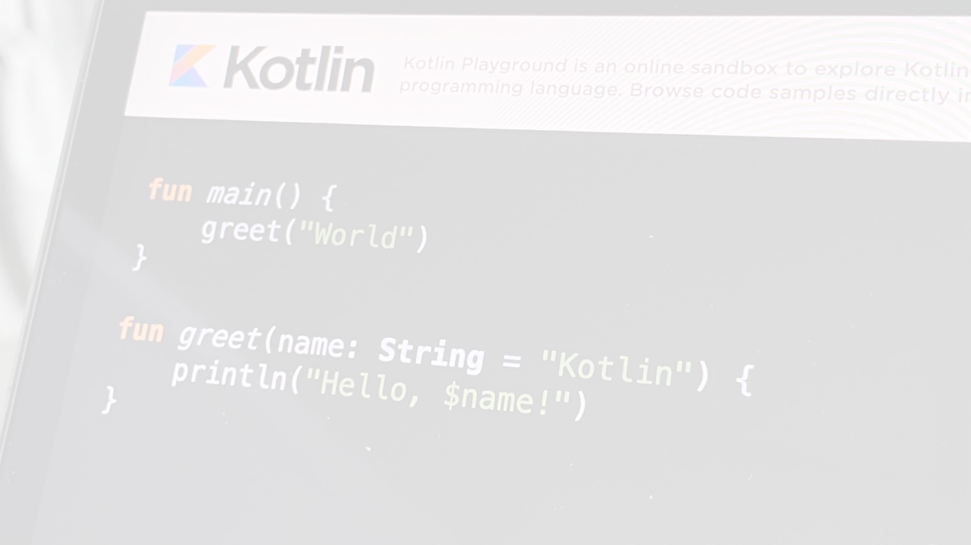
is and !is operators﻿
Use the is operator or its negated form !is to perform a runtime check that identifies whether an object conforms to a given type:
if (obj is String) {
print(obj.length)
}
if (obj !is String) { // Same as !(obj is String)
print("Not a String")
} else {
print(obj.length)
}

Slide 3
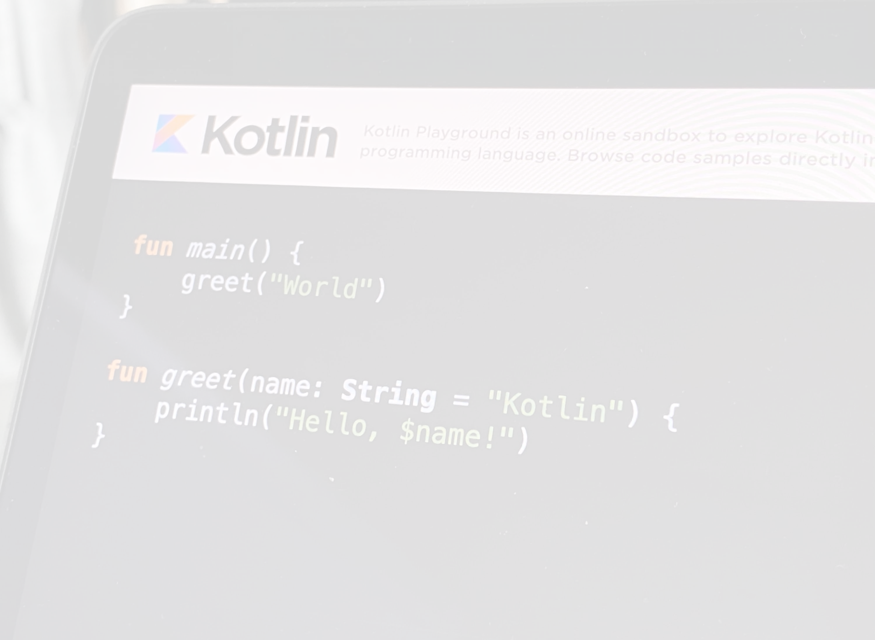
Smart Casts﻿
In most cases, you don't need to use explicit cast operators in Kotlin because the compiler tracks the is-checks and explicit casts for immutable values and inserts (safe) casts automatically when necessary:
fun demo(x: Any) {
if (x is String) {
print(x.length) // x is automatically cast to String
}
}
The compiler is smart enough to know that a cast is safe if a negative check leads to a return:
if (x !is String) return
print(x.length) // x is automatically cast to String
Or if it is on the right-hand side of && or || and the proper check (regular or negative) is on the left-hand side:
// x is automatically cast to String on the right-hand side of `||`
if (x !is String || x.length == 0) return
// x is automatically cast to String on the right-hand side of `&&`
if (x is String && x.length > 0) {
print(x.length) // x is automatically cast to String
}
Smart casts work for when expressions and while loops as well:
when (x) {
is Int -> print(x + 1)
is String -> print(x.length + 1)
is IntArray -> print(x.sum())
}

Slide 4
"Unsafe" Cast Operator﻿
Usually, the cast operator throws an exception if the cast isn't possible. Thus, it's called unsafe. The unsafe cast in Kotlin is done by the infix operator as.
val x: String = y as String
Note that null cannot be cast to String, as this type is not nullable. If y is null, the code above throws an exception. To make code like this correct for null values, use the nullable type on the right-hand side of the cast:
val x: String? = y as String?

Slide 5
"Safe" (nullable) Cast Operator﻿
To avoid exceptions, use the safe cast operator as?, which returns null on failure.
val x: String? = y as? String
Note that despite the fact that the right-hand side of as? is a non-nullable type String, the result of the cast is nullable.

